Slide 1

Contouring Station – Practice

Slide 2
This document is designed to allow candidates sitting the FRCR CO2B examination to familiarise themselves with the contouring station (which is an interactive 16-minute station).
It is recommended that you download this Powerpoint file and practice the following over a Teams call with someone else.
Candidates will need to familiarise themselves with two functions on slide show/presentation mode:
1. To scroll 3D image datasets (to identify / interpret the findings and facilitate contouring)
The 3D image dataset can be “played” after clicking / hovering over the image
It can then be “paused” and the images navigated by left clicking the mouse and dragging
the progress bar left and right along the bottom
The 3D image sets can only be scrolled through when the pen function is “off”
2. To use the pen function to outline on a representative slice provided
Candidates will need to be able to switch on and off the “pen” function

Slide 3
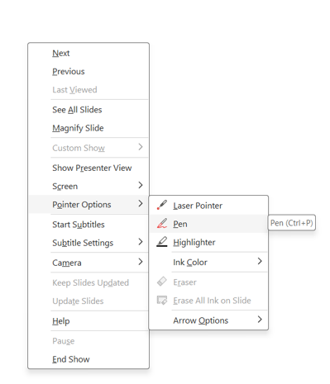
Useful Tips:
1. The pen is accessed by “right clicking” on the screen, choosing “pointer options” and then selecting “pen” (as shown on the right)
Repeating this process enables the pen to be toggled off again
2. Scrollable image series are outlined in red. Slices to draw on are outlined in green.

Slide 4
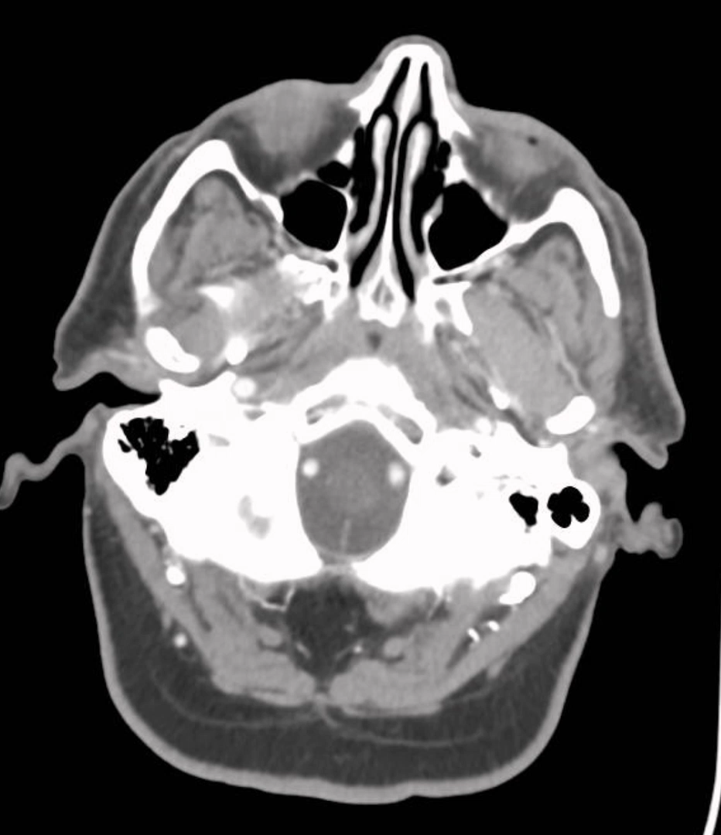
Practice scrolling through the CT series below and identify the abnormalities as described on the CT report
Tip:
Hover your cursor over the image on the left to see and press the “play” symbol.
Pause play along the progress bar in the bottom of the image.
Then, left click the mouse and “drag” the bar left or right to scroll through the images as required.
CT Report:
3 cm supraglottic tumour, involving pre epiglottic space and right aryepiglottic fold
Right level 3 lymphadenopathy
Left level 2 lymphadenopathy

Slide 5
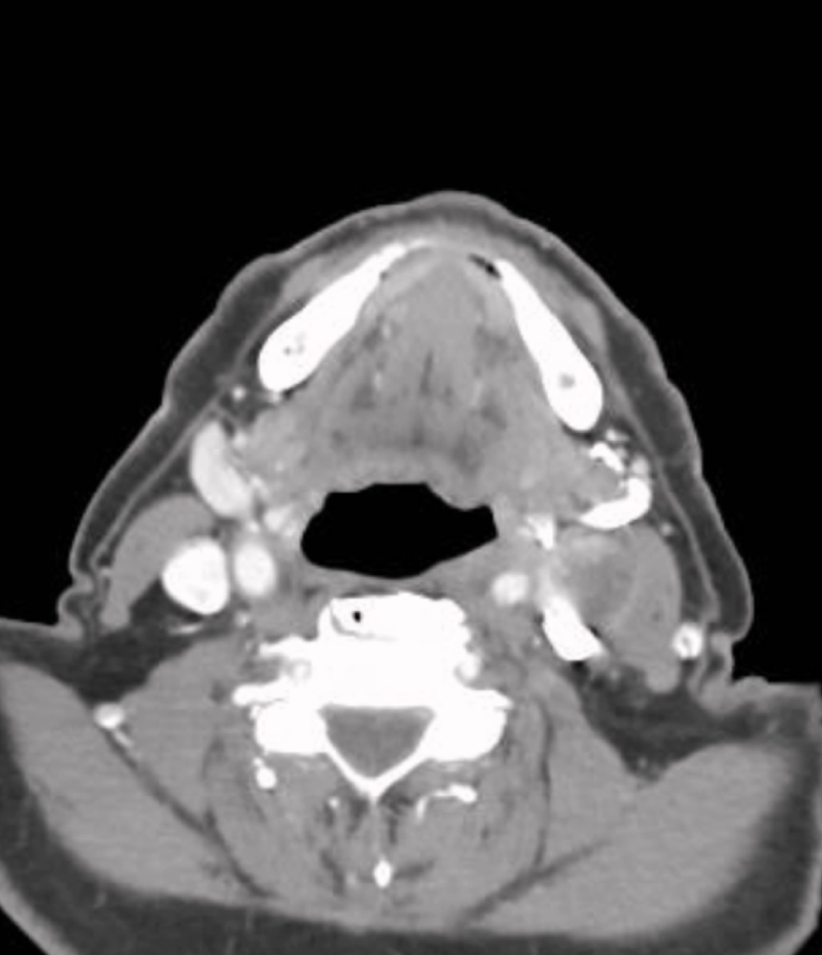
On this slide you are being asked to contour GTVnode.
Practice scrolling through the CT series (on the left) to find the slice shown on the right.
When you are happy with the anatomy, select the pen function (right click) and outline the required structure on the chosen slice on the right
Remember:
Scrollable image data sets usually have a red border (left)
Individual slices for drawing have a green border (right)

Slide 6
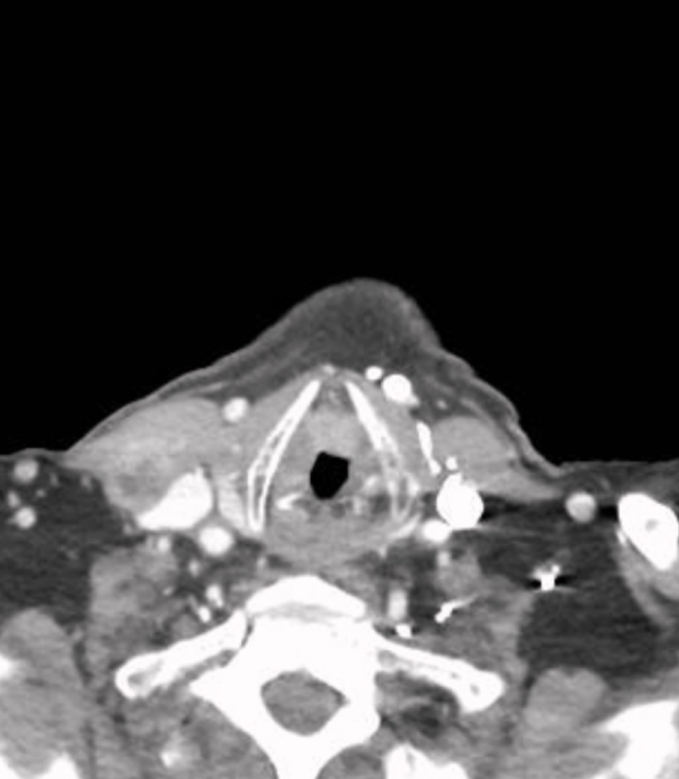
On this slide you are being asked to contour both GTVprimary and GTVnode.
Practice scrolling through the CT series (on the left) to find the slice shown on the right.
When you are happy with the anatomy, select the pen function (right click) and outline the required structures on the chosen slice on the right

Slide 7
Notes:
The scrollable images are provided to mimic work you do in your planning system. Use them, as you would normally, to clarify the anatomy before contouring. e.g. what is a node vs a muscle or a blood vessel?
The examiner will move you through the slides during the exam. They will listen to what you say, watch what you draw and help you if there is a technical problem.
Remember - you have to switch the pen off to scroll again.
There is an “eraser” function under the “pointer options” menu that can be used to delete a completely wrong contour – but the whole contour disappears.

